Slide 1


A Comprehensive Study on Paraphrase Detection: Innovations, Challenges, and Applications in Plagiarism Detection
CS9811 – Readings in Data Science
April 2024
Nanda Kishore Kappaganthula
Supervision: Dr. Dan Lizotte

Slide 2
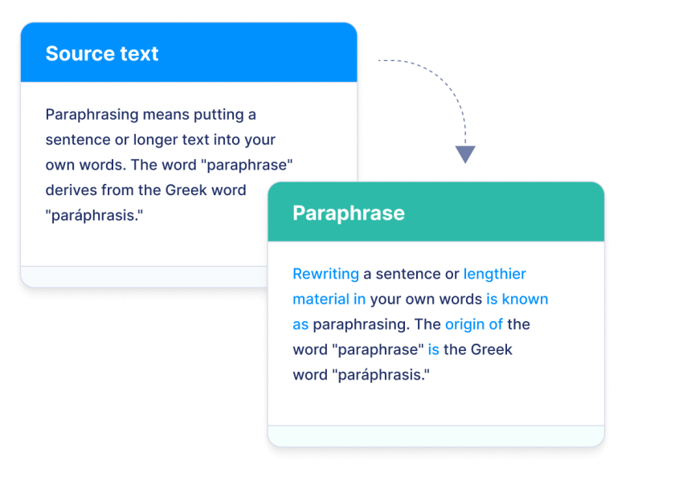
Introduction to Paraphrase Detection
In natural language processing, paraphrase detection is an essential task that allows the recognition of semantically comparable content.
This introduction delves into the most recent advancements, difficulties, and practical uses of this potent text analysis method, specifically with regard to plagiarism detection.

Slide 3
Importance of Paraphrase Detection in the Digital Age
Proliferation of Online Content
Paraphrase identification is an essential technique because of the increasing risk of plagiarism and copyright infringement caused by the rapid proliferation of digital information.
Academic Integrity
Paraphrase detection helps preserve academic integrity in educational environments by spotting instances of copying and discouraging student plagiarism.

Slide 4
Importance of Paraphrase Detection in the Digital Age
Intellectual Property Protection
By identifying instances of unapproved use of their information online, paraphrase detection helps businesses protect their intellectual property.
Information Retrieval and Summarization
By detecting semantically similar content, paraphrase detection improves the accuracy of text summarization and information retrieval systems.

Slide 5

Challenges in Paraphrase Detection
Semantic Variations:
Because paraphrases can have minute variations in meaning, it could be challenging to find commonalities between them.
Data Sparsity:
The size limitations of annotated paraphrase datasets make it difficult to train trustworthy detection algorithms.
Domain Specificity:
Paraphrases might vary significantly between academic subjects or domains, requiring the deployment of specific identification techniques.
Ambiguity:
Statements that are unclear or have ambiguous linguistic structures can cause algorithms that identify paraphrases to malfunction.

Slide 6
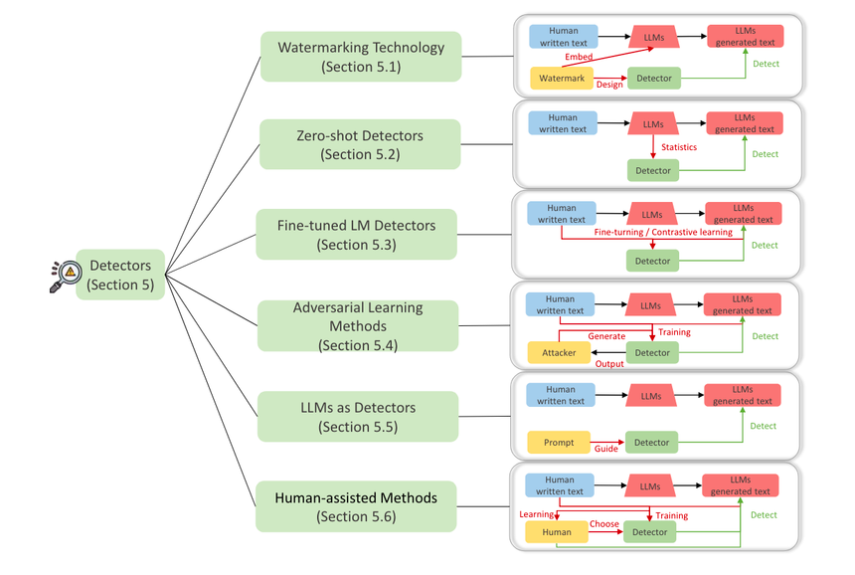
Approaches to Paraphrase Detection
Lexical and Syntactic Analysis:
This technique looks at word choice, sentence structure, and grammar to determine paraphrases.
Feature-based approaches:
Using feature-based methods, linguistic features including word embeddings, n-grams, and syntactic patterns are extracted for use in similarity computations.
Neural Network Models:
For paraphrase detection, deep learning designs including transformers, convolutional neural networks, and recurrent neural networks (RNNs) are used.
Graph-Based Models: To capture semantic links, words are represented as nodes in a graph network using graph convolutional networks (GCNs).

Slide 7

How Large Language Models are Transforming Machine-Paraphrased Plagiarism
Use of Large Language Models (LLMs) in Paraphrase Detection:
GPT-3 and T5 are used to generate and identify plagiarism that has been machine-paraphrased.
Plagiarism that is machine-paraphrased is rewriting texts while keeping their original meaning.
Large-Scale Study of Machine-Paraphrase Generation:
Research done on Wikipedia, student theses, and scientific publications.
Comparison of the quality, diversity, and resemblance to the source texts of the T5 and GPT-3 tests.

Slide 8
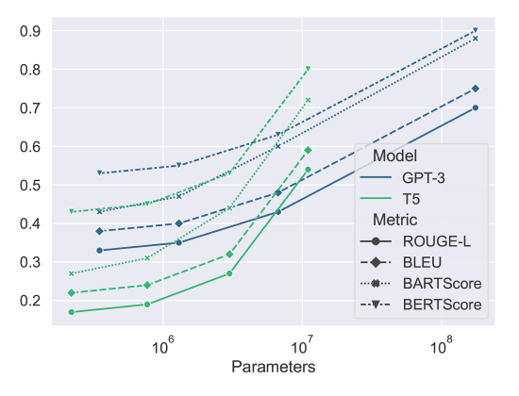
How Large Language Models are Transforming Machine-Paraphrased Plagiarism
Evaluation of Detection Performance:
One commercial plagiarism detection program and six automated solutions were assessed.
The efficacy of current methods for detecting plagiarism that has been machine-paraphrased is limited.
GPT-3 performs the best, displaying an F1-score of 66%.
Human Study on Detection Ability and Paraphrase Quality:
A human study with 105 individuals was done on detection ability and paraphrasing quality.
Machine-paraphrased plagiarism is difficult for humans to detect—its average accuracy is only 53%.
Human experts gave the GPT-3-generated paraphrases good marks for coherence, clarity, and fluency.

Slide 9
Modeling the Paraphrase Detection Task over a Heterogeneous Graph Network with Data Augmentation
Motivation: Addressing the paraphrase detection task in natural language processing.
Applications: Including plagiarism detection, text summarization, and question answering.
Challenges: Reviewing existing methods and highlighting limitations.
Main Contributions: Proposing a graph structure representation and back-translation strategy.
Components: Graph structure representation and graph convolutional network for semantic similarity.
Data Augmentation: Utilizing back-translation to increase paraphrase diversity.
Illustrations: Providing examples to demonstrate the approach.
Dataset: Using the ASSIN 2 corpus, a benchmark dataset for paraphrase detection in Portuguese.
Evaluation Metrics: Measuring accuracy, precision, recall, and F1-score.

Slide 10
Modeling the Paraphrase Detection Task over a Heterogeneous Graph Network with Data Augmentation
Implementation Details: Describing architecture, back-translation languages, and optimization algorithm.
Performance: Achieving state-of-the-art results on the ASSIN 2 corpus.
Ablation Study: Analyzing the impact of each approach component.
Qualitative Examples: Illustrating successful and unsuccessful cases and discussing reasons behind them.
Summary: Highlighting main contributions and findings.
Significance: Emphasizing the novelty and significance of the proposed approach.
Future Directions: Extending to other languages/domains, exploring graph neural networks, and incorporating additional data augmentation techniques.
Baseline Methods: Comparing with SVM, CNN, and BERT.

Slide 11
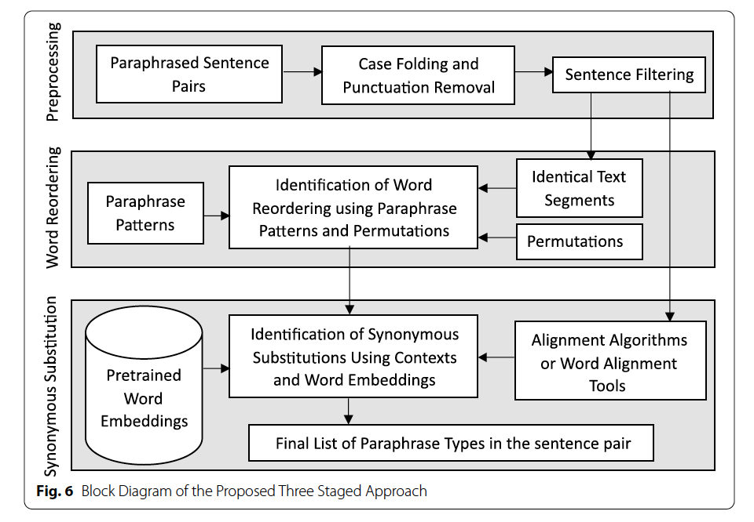
Paraphrase type identification for plagiarism detection using contexts and word embeddings
Problem Statement:
discussing lexical and semantic changes in the detection of paraphrase plagiarism.
Pay close attention to the two main types of paraphrases: word reordering and synonymous substitution.
Help human assessors make well-informed choices about situations of plagiarism.
Proposed Approach: Three-staged methodology:
Preprocessing: utilizing spaCy for part-of-speech tagging, tokenization, and lemmatization.
Context Matching: Finding common subsequences by applying the Smith Waterman Algorithm.
Word Embedding Comparison: To identify different forms of paraphrases, compute the cosine similarity between pretrained embeddings.

Slide 12
Paraphrase type identification for plagiarism detection using contexts and word embeddings
Evaluation:
Datasets - PAN-PC-10 and PAN-PC-11 datasets are from the PAN competition for plagiarism detection.
Metrics - F1 scores, precision, and recall are evaluated for every word embedding model and dataset.
Comparison - surpasses baseline method for synonymous substitution identification with WordNet.
Findings:
Best Performance - Word embeddings from ConceptNet Numberbatch yielded the best performance.
Limitations - managing multi-word phrases, insertion/deletion, and semantic drift.
Future Directions - extending to additional languages, adding contextualized embeddings, and incorporating syntactic information.
Novelty and Significance:
Uniqueness - Combining pretrained embeddings with context matching to identify the type of paraphrase.
Complementarity - By offering insights into paraphrase techniques, it improves on the existing plagiarism detection algorithms.
Potential Impact - Provides human assessors with a more knowledgeable evaluation of the degree and intent of plagiarism.

Slide 13
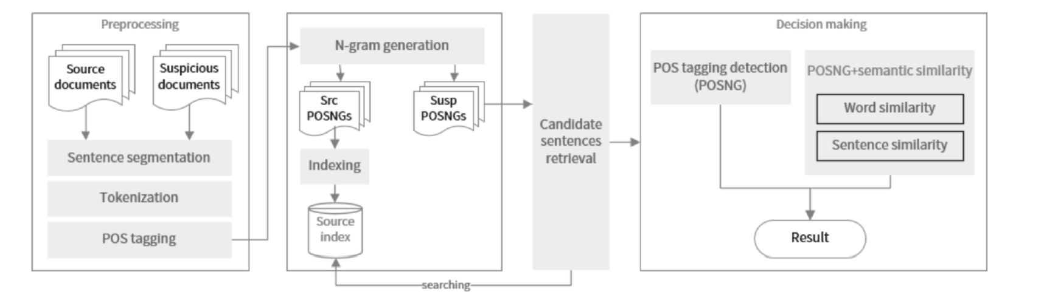
An external plagiarism detection system based on part-of-speech (POS) tag n-grams and word embedding
Introduction:
Problem: Plagiarism detection is crucial for maintaining academic integrity.
Contribution: Proposed system utilizes POS tag n-grams and word embedding for external plagiarism detection.
Background: Brief overview of POS tagging and word embedding.
Architecture: Overview of the proposed system's components.
Related Work:
Literature Review: Overview of existing methods categorized into character-based, word-based, and syntactic-based approaches
Comparison: Comparison with state-of-the-art systems highlighting advantages and limitations
Proposed Method:
Four-step process: preprocessing, feature extraction, similarity calculation, and classification.
Utilization of POS tag n-grams and word embedding for syntactic and semantic similarity measurement.
Application of threshold for classifying sentences as plagiarized or not.

Slide 14
An external plagiarism detection system based on part-of-speech (POS) tag n-grams and word embedding
Experiments and Results:
Evaluation conducted on PAN-PC-10 and PAN-PC-11 datasets.
Performance assessment using precision, recall, and F1-score metrics.
Examination of parameter effects such as n-gram size, word embedding dimension, and similarity threshold.
Analysis of parameter and feature impact on results.
Conclusion and Future Work:
Summary of main findings and contributions.
Statement on competitive results achieved using syntactic and semantic features.
Suggestions for future work, including improving semantic similarity measure and incorporating more features.

Slide 15

Optimization of paraphrase generation and identification using language models in natural language processing
Introduction:
Problem: Paraphrase identification and generation are essential tasks in NLP.
Contribution: Proposal of a unified model using fine-tuned T5 for both tasks.
Background: Brief overview of paraphrase identification and generation.
Related Work:
Review: Overview of related work in NLP, focusing on natural language generation and language models.
Limitations: Highlight limitations of existing methods in solving both tasks simultaneously.

Slide 16
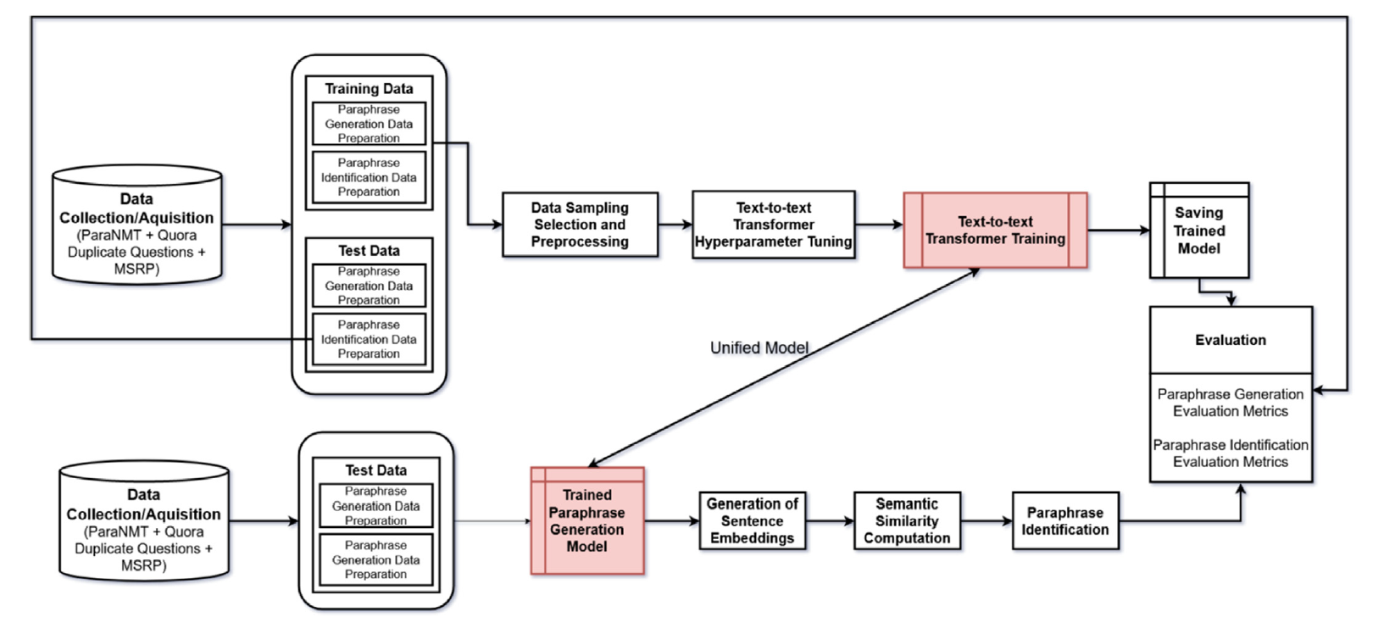
Optimization of paraphrase generation and identification using language models in natural language processing
Proposed Approach - data sampling, model fine-tuning, and inference.
Data Sampling: Explanation of criteria for selecting data subsets based on semantic similarity, expression diversity, and language fluency.
Model Fine-Tuning: Process of adapting a pre-trained T5 model for paraphrase generation using a special token and cross-entropy loss function.
Inference: Explanation of how the fine-tuned model is used for either generation or classification.

Slide 17
Optimization of paraphrase generation and identification using language models in natural language processing
Evaluation on Benchmark Datasets:
Benchmark datasets - ParaNMT-50M for paraphrase creation and Quora Question Pairs (QQP) for paraphrase detection.
Evaluation criteria include F1-score, BLEU, ROUGE, METEOR, WER, GLEU, accuracy, precision, and recall.
Comparison of cutting-edge techniques (PEGASUS, UniLM) and baseline techniques (BERT, GPT-2, T5-base).
Findings and Interpretation:
Superiority of the suggested model over baseline techniques for both tasks.
Comparative analysis using cutting edge techniques.
Ablation study to examine the effects of several elements.
Limitations and Future Work:
Discussion about the constraints, such as managing complex phrases and enhancing fluency and diversity.
Future research ideas include expanding the model to handle additional tasks involving the creation of natural language.

Slide 18
BERT: Pre-training of Deep Bidirectional Transformers for Language Understanding
Introduction:
BERT (Bidirectional Encoder Representations from Transformers) introduced as a novel language representation model.
Motivation: Need for better models to capture both syntactic and semantic information from unlabeled text.
BERT's approach: Pre-train deep bidirectional representations by conditioning on both left and right context.
Key pre-training objectives: Masked Language Model (MLM) and Next Sentence Prediction (NSP).
Achievements: State-of-the-art performance on various NLP tasks.
Related Work:
Overview of prior work in language representation learning.
Comparison with other models like ELMo and GPT.
Discussion on different pre-training objectives and transfer learning methods.
Contextualization of BERT's significance within the existing landscape of language models.

Slide 19
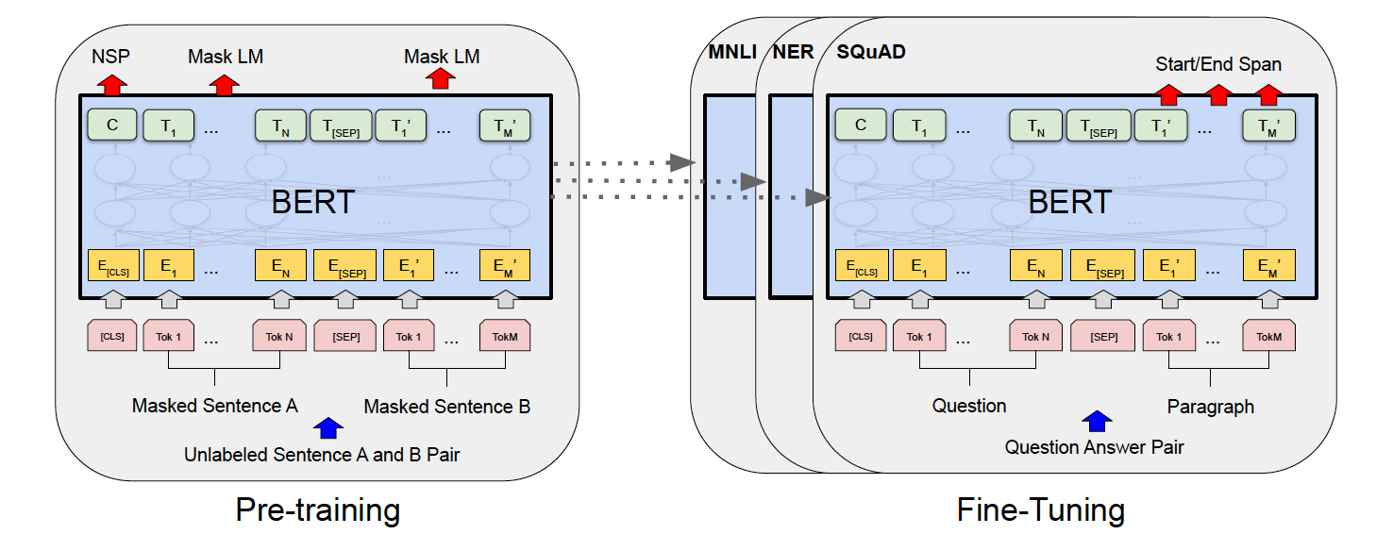
BERT: Pre-training of Deep Bidirectional Transformers for Language Understanding
BERT:
Description of BERT's architecture, including the Transformer encoder.
Explanation of the masked language model (MLM) and next sentence prediction (NSP) objectives.
Details on pre-training data, hyperparameters, and optimization methods.
Fine-tuning procedure for different downstream tasks.
Experiments:
Evaluation of BERT on eleven natural language processing tasks.
Comparison with baseline models and ablations.
Reporting of results in terms of accuracy, F1 score, etc.
Analysis of factors affecting BERT's performance, such as model size and pre-training data size.

Slide 20
BERT: Pre-training of Deep Bidirectional Transformers for Language Understanding
Ablation Studies:
Investigation into the impact of pre-training objectives and bidirectional context.
Conducting experiments to analyze the effects of removing NSP and using unidirectional context.
Discussion on the importance of bidirectional context and coherent sentences for BERT.
Conclusion:
Summary of key findings and contributions of the paper.
Discussion on limitations and future directions of BERT.
Suggestions for possible extensions and applications.
Conclusion on the significance of BERT in advancing language representation learning.

Slide 21

Conclusion
For the purpose of promoting ethical communication, upholding academic integrity, and improving information retrieval, paraphrase detection is essential.
Large Language Models (LLMs) such as BERT, GPT-3, and T5 have made tremendous progress in improving their ability to detect paraphrases.
Semantic modifications, data sparsity, and ethical issues continue to pose problems, nevertheless.
Overcoming these obstacles and advancing paraphrase detection require interdisciplinary cooperation, creative thinking, and the development of ethical AI.
Let's keep working to advance knowledge and promote moral communication to build a time when language comprehension will benefit people's lives and transcend all barriers.

Slide 22

Thank You!!

